Slide 1
Reconstruction

Slide 2
Table of Contents
Famous Tennesseans and Infantry Soldier Accounts
Date | Topic | Slide #
4/27/21 | Vocabulary | 3
4/27/21 | Vocabulary | 4
4/27/21 | The Epic Failure of Reconstruction - Crash Course #22 | 5
4/27/21 | 13th, 14th, & 15th Amendments | 6
4/29/21 | Reconstruction Plans and Conflict | 7
4/29/21 | Andrew Johnson’s Impeachment | 8
5/4/21 | Opportunities During Reconstruction | 9
5/4/21 | William Brownlow & the TN Constitution | 10
5/4/21 | Reconstructions End and Suppression in the South | 11
 |  | 12
 |  | 13
 |  | 14
 |  | 15
 |  | 16
 |  | 17
 |  | 18
 |  | 19
 |  | 20
 |  | 21

Slide 3
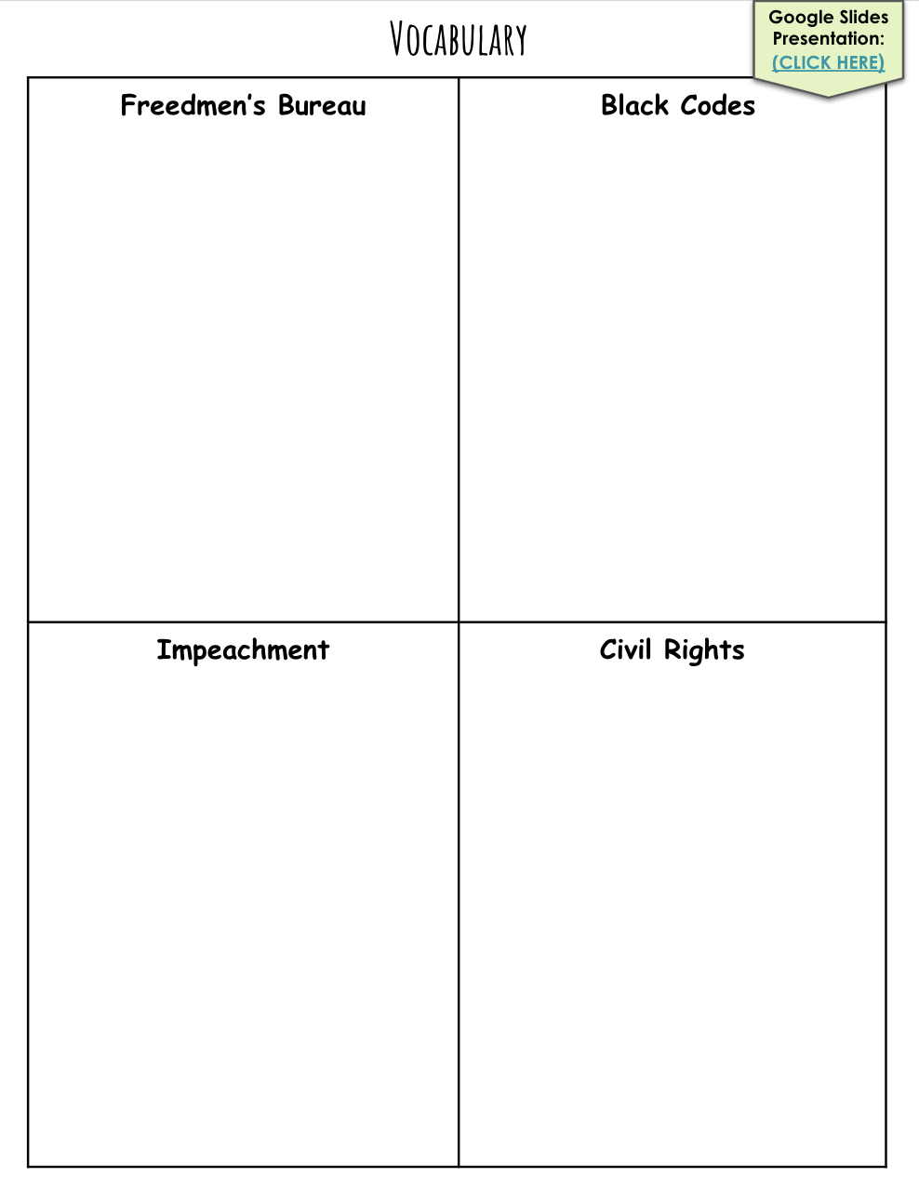
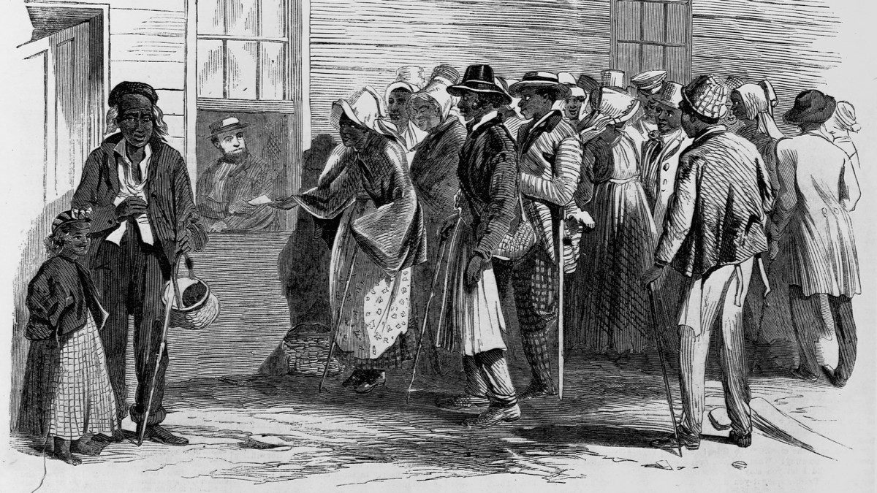
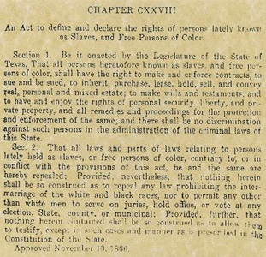
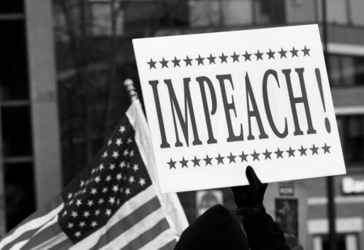
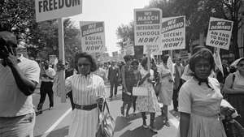
Google Slides Presentation:
(CLICK HERE)
An agency established by congress in 1865 to help poor people in the south
Laws passed in the southern states following the civil war that limited the freedom of newly freed slaves
The process used by a legislative body to bring charges of wrongdoing against a public official
Basic rights every citizen has under the laws of government

Slide 4
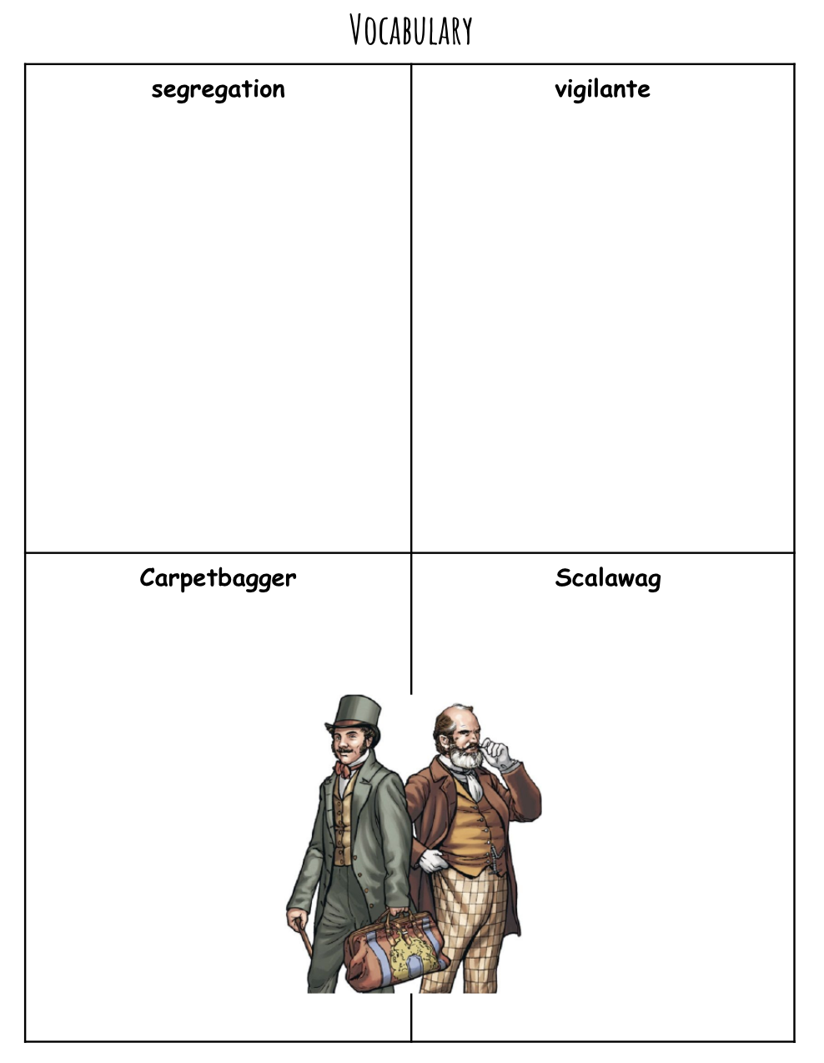
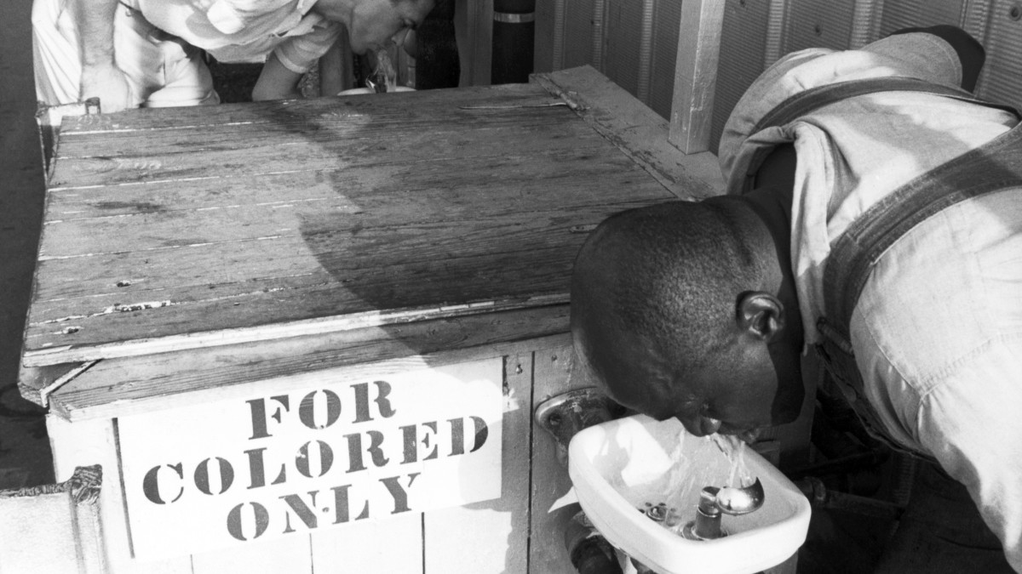
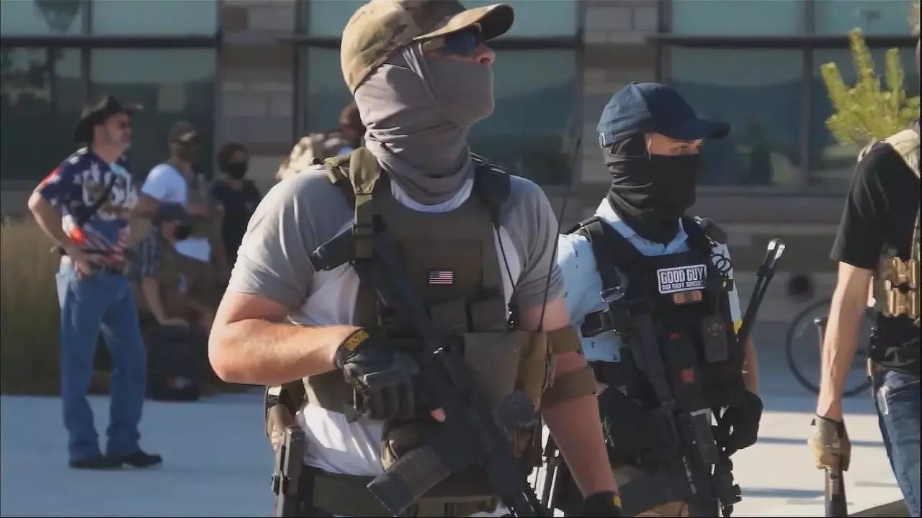
The forced separation of people of different races in public
A member of a group of volunteers who are not police but decide on their own to stop crime and punish criminals
A northerner who moved to the south after the civil war often for economic opportunities
A white southerner who supported the federal plan of reconstruction

Slide 5
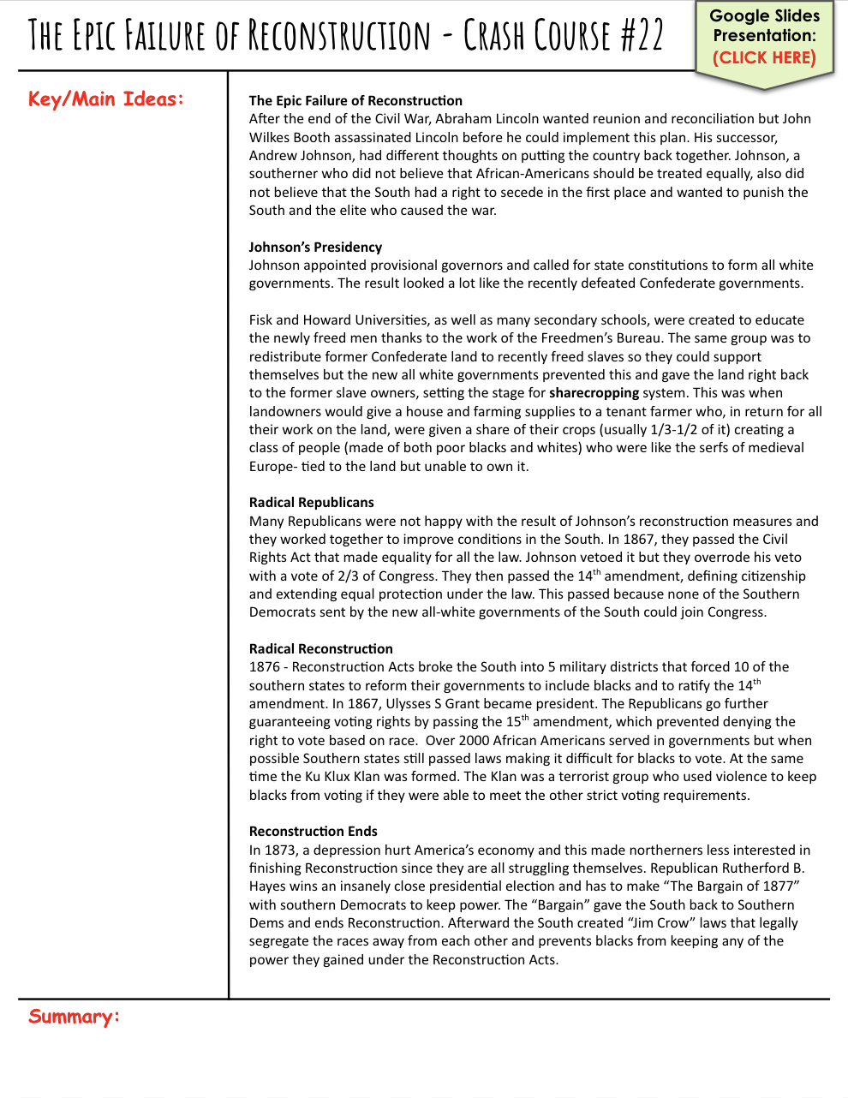
Google Slides Presentation:
(CLICK HERE)
Lincoln wanted a reunion and reconciliation
He was assassinated before this
Johnson was appointed
He was racist
Wanted to form all white governments
Fisk and Howard University were created to educate african americans
Gave land back to original owners and then there was the sharecropping
Republicans were not happy with the result of johnson’s construction
They passed the civil rights act
Passed the 14th amendment
1876 reconstruction acts broke the south into 5 military districts
Forced 10 southern states to reform
Ulysees s grant was elected
Guaranteed voting rights by passing the 15th amendment
Over 2000 african americans served in the governments
South was still passing laws to stop them
KKK was formed
In 1873 a depression hurt america
Hayes wins close presidential election
Lincoln wanted a reunion but was killed. Johnsons presidency was bad. He was racist and it ended up leading into the KKK. After other things.

Slide 6
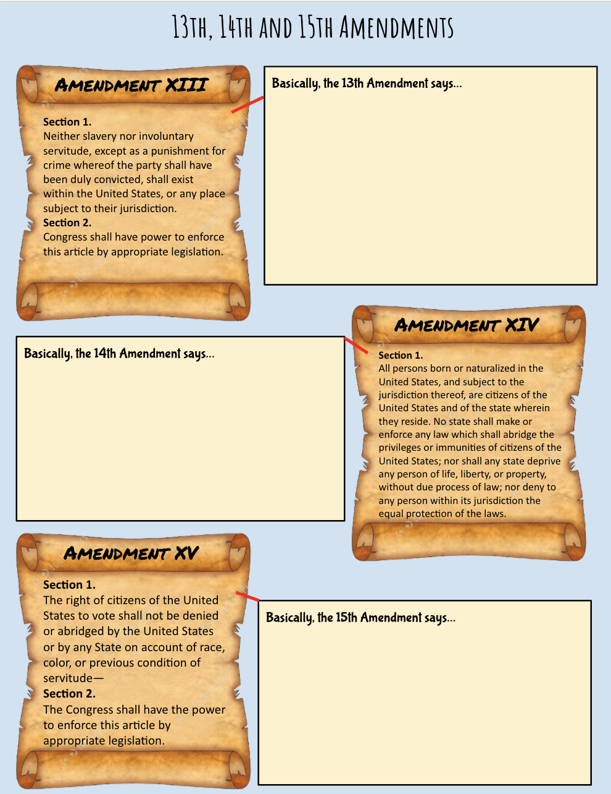
Slavery will not be allowed or involuntary servitude except as a punishment. Congress will have power to enforce it
Everyone born in the US are citizens of the US. no state can enforce any laws taking away privileges from any citizens.
Everyone can vote no matter what the race.

Slide 7
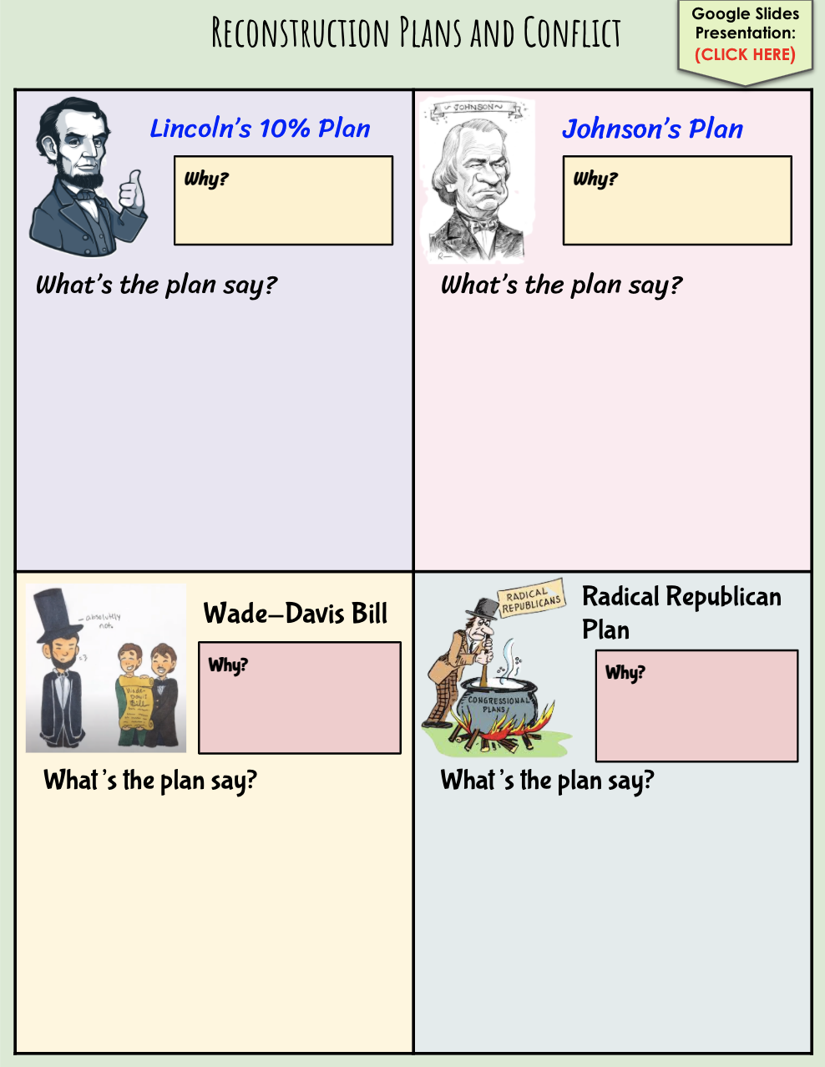
Google Slides Presentation:
(CLICK HERE)
Wanted a quick reunion
Because he was tennessean
Offered a pardon to those who supported the rebellion
To get back in they had to swear an oath
And agree slavery was illegal
Opposition came from wade davis bill
State leaders had to revise their constitution
The people elected the new state governments
They had to agree secession was illegal
Had to ratify the 13th amendment
Wanted the congress to let them back in
They were at odds with the president
Congress felt they should readmit them
states had to agree and even people had to swear oaths
Outlined radical reconstruction
Wanted harsher terms to the states coming back

Slide 8
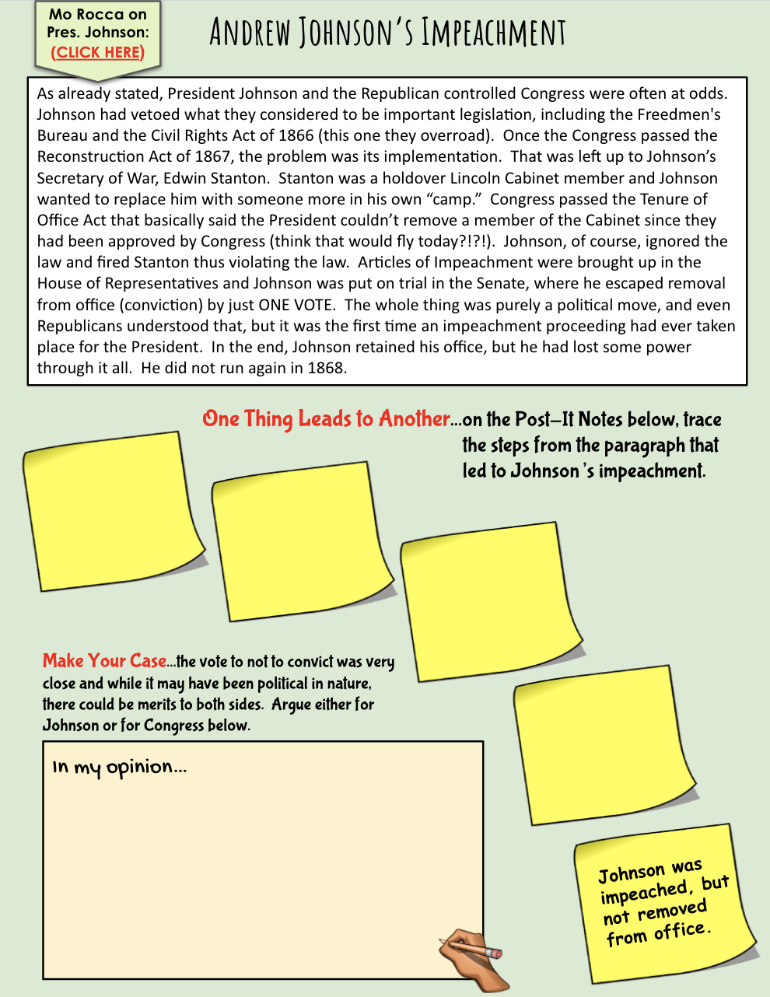
Mo Rocca on Pres. Johnson:
(CLICK HERE)
Johnson vetoed what they thought was important
Johnson replaced one of lincoln’s cabinet members
Johnson ignored the newly passed law and fired him
Went to congress and one the votes by one single vote
I think that johnson should have been impeached because if you just break a law like that you shouldn’t be able to be in office. Also if he was impeached I think he should’ve just left office.

Slide 9
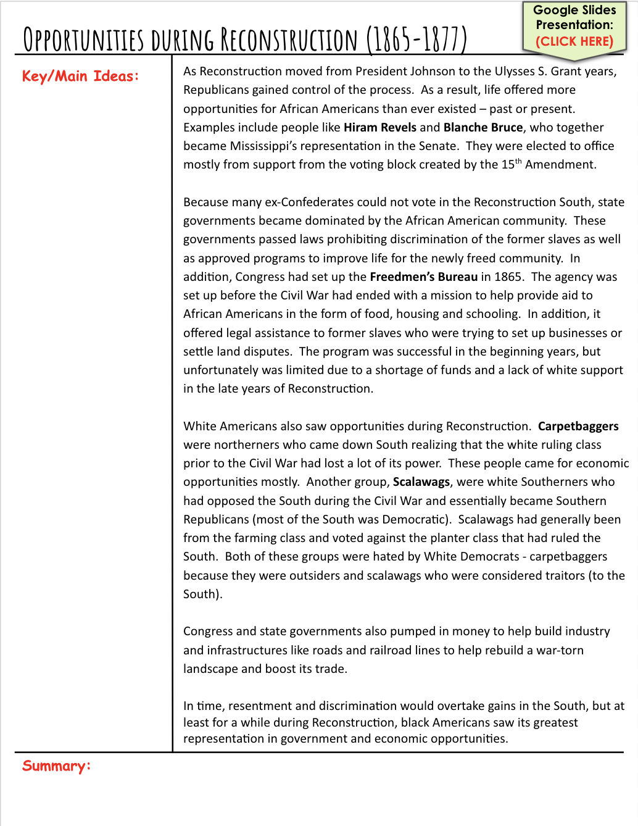
Google Slides Presentation:
(CLICK HERE)
Republicans gained control of the process
Offered more opportunities to african americans
They were mainly elected because of the 15th amendment
State governments became dominated by african americans because confederates couldn’t vote
They made laws that prohibited things like slavery
Freedmen's bureau was created to protect african americans and give them supplies to live
Carpetbaggers were northerners who went down to the south
Scalawags were white southerners who opposed the revolt
Scalawags were usually farmers
Congress and state governments gave money to help rebuild
Overtime discrimination will come back in the south
Republicans and the government helped rebuild. People like carpetbaggers and scalawags came around. The freedmen's bureau was passed and it gave many african americans more rights and some even got government jobs.

Slide 10
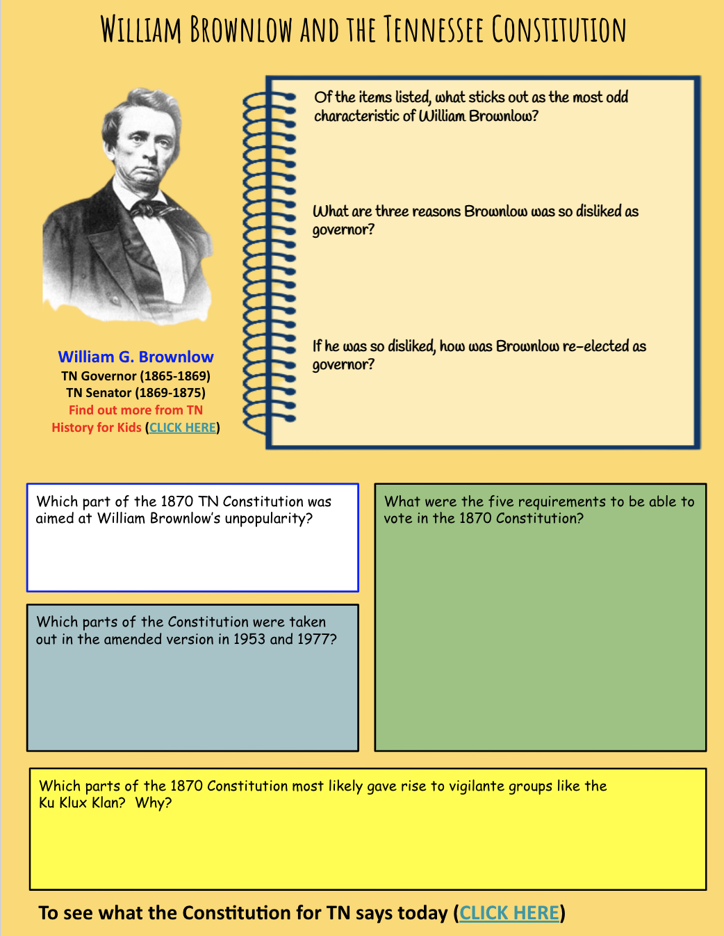
Started as a preacher
he was once a slaveholder. But when Civil War broke out, he became one of Tennessee’s most vocal unionists. Brownlow was sent to prison by the Confederate government. an election in which all men who had fought for the Confederacy were not allowed to vote. Largely because of this, Brownlow was hated
He was re-elected to that position in 1867 — an election in which all men who had fought for the Confederacy were not allowed to vote.
(CLICK HERE)
Him being a part of the confederacy And people being ministers couldn’t
Had to be over 21
No infamous crimes
As long as they payed their poll tax
Banned interracial marraige
And people being ministers couldn’t
That ministers were not allowed to be part of the legislative
They can carry firearms if they are stopping crime
(CLICK HERE)

Slide 11
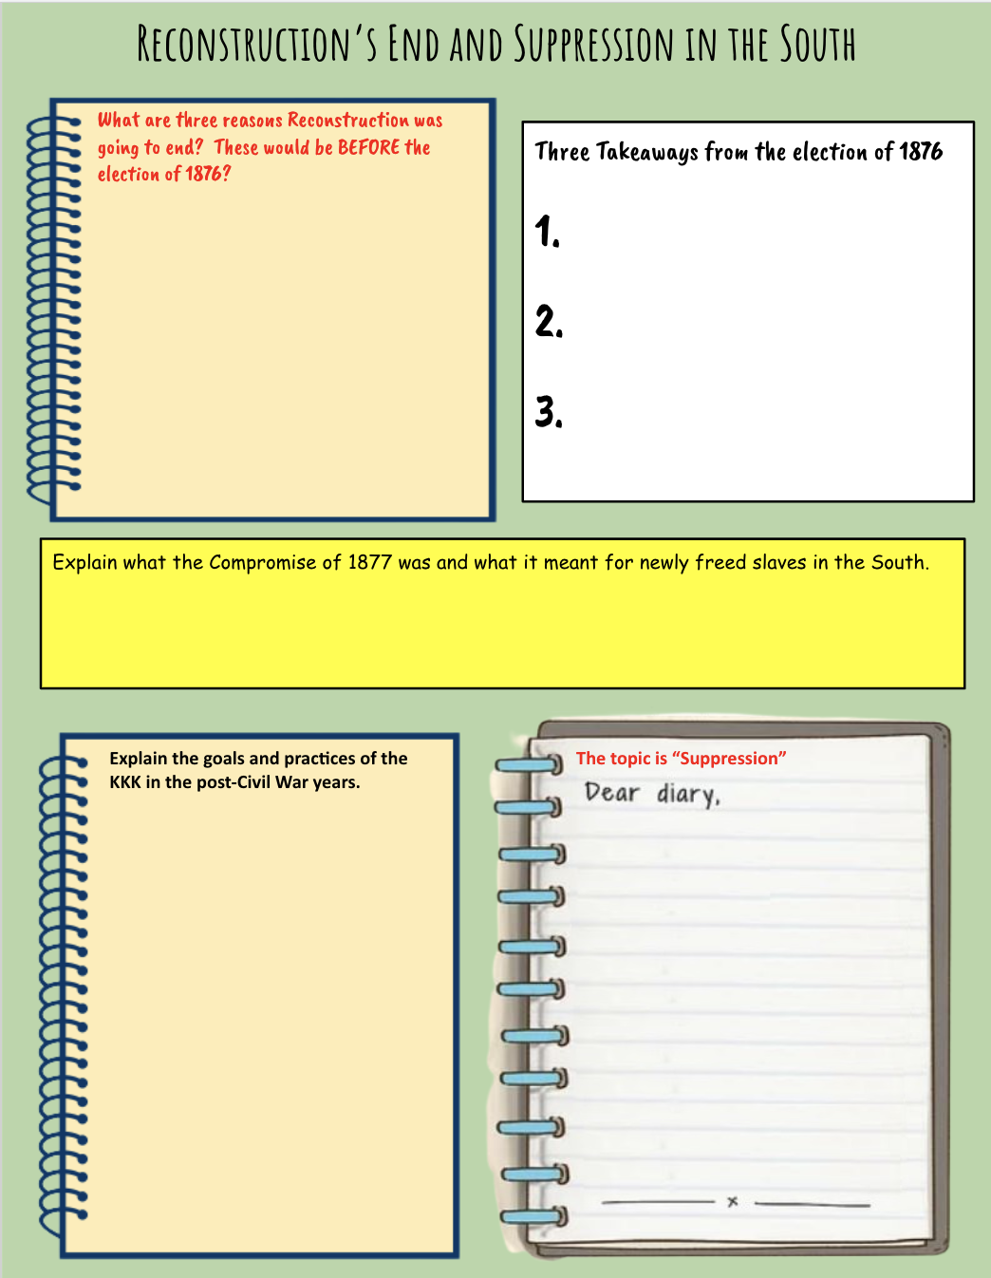
Issues shifted over time.
An increasingly violent south.
National economic hardships
Rutherford B hayes (rep) and samuel tilden (dem) ran for president
Samuel tilden appeared to have one but it changed
Results in a number of states were challenged
Hayes one the election and ended military occupation of the south. This got rid of most of african americans rights.
They wanted to get all of the power back to the whites.
They lynched
They destroyed properties
Murder in the black comunity
The clan started in tennessee
The KKK was formed and they wanted to shift all of the power back to the whites. By doing so they killed many african americans. They lynched many of them and intimidated whites too. The nation ended up going into the jim crow era and remained for a long time.
Christian Thompson

